Slide 1
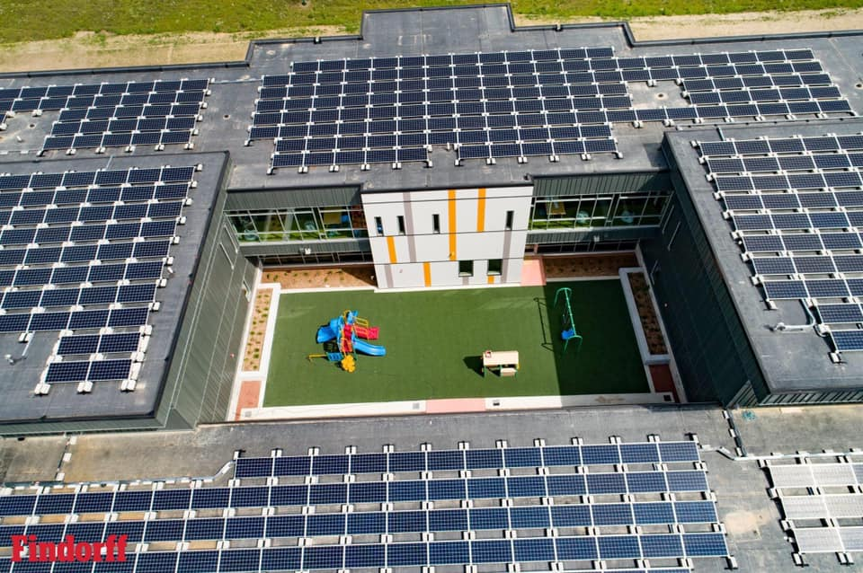

Solar at [school district name]

Slide 2
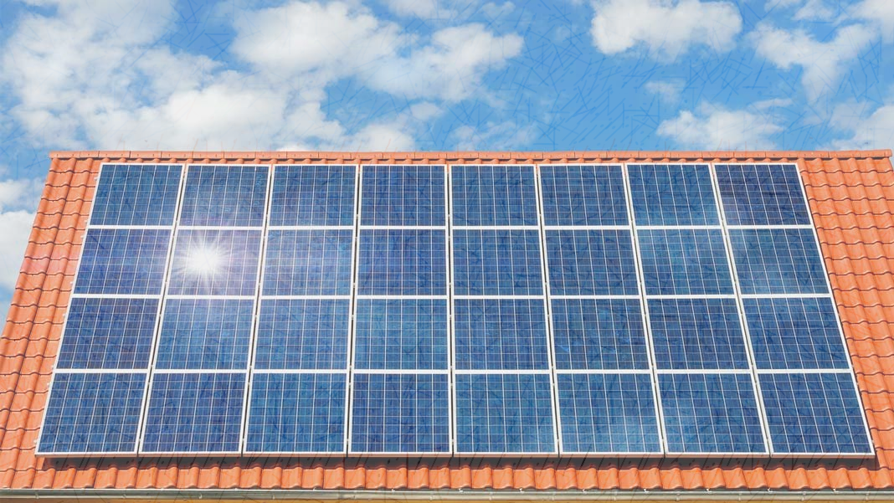

This Presentation Covers:
What are the benefits of going solar? Why should our school consider solar? What is the cost of solar? What warranties are relevant to the system? How much energy does the system produce? What will the system save our school annually? What’s the typical system lifespan? How does snow impact collection? What roof considerations do I need to know? What happens if there are failures in the system? What are the next steps?

Slide 3
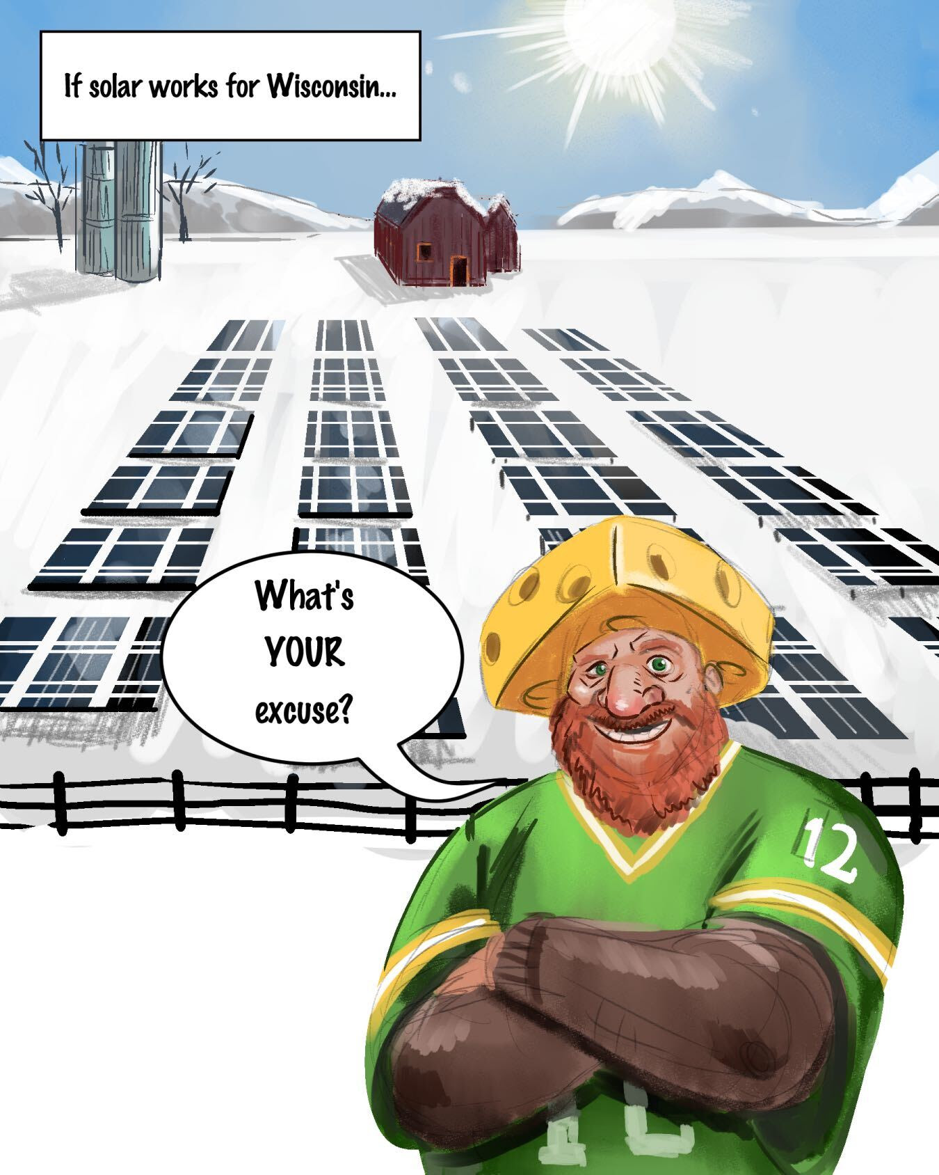
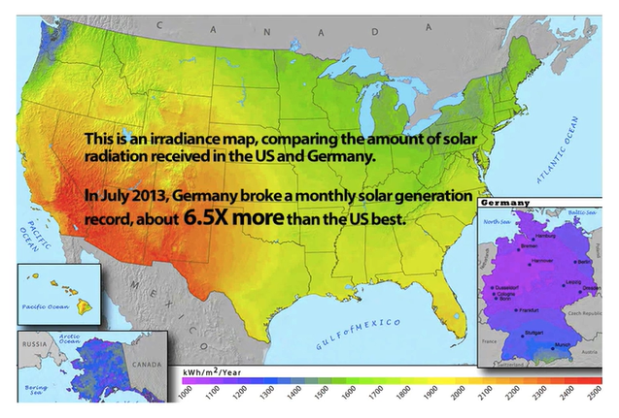
Wisconsin and Solar
www.gasswest.com
Notes:
A lot of people seem to think that solar can’t work in WI. But it definitely can – Germany is a world leader in solar, and they get about as much direct sun as Alaska does. Plus, there are ways to design your systems with WI winters in mind – such as installing ground mounted systems using bifacial modules (collect sun/create energy on BOTH sides of the modules), both of which help with quickly shedding snow and maximizing winter energy production.

Slide 4
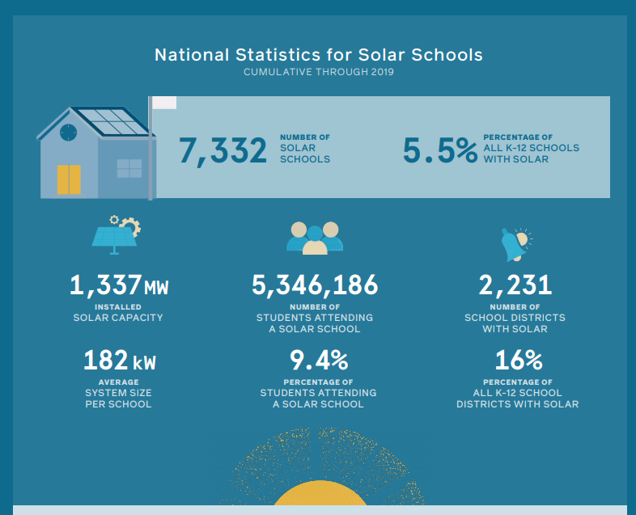
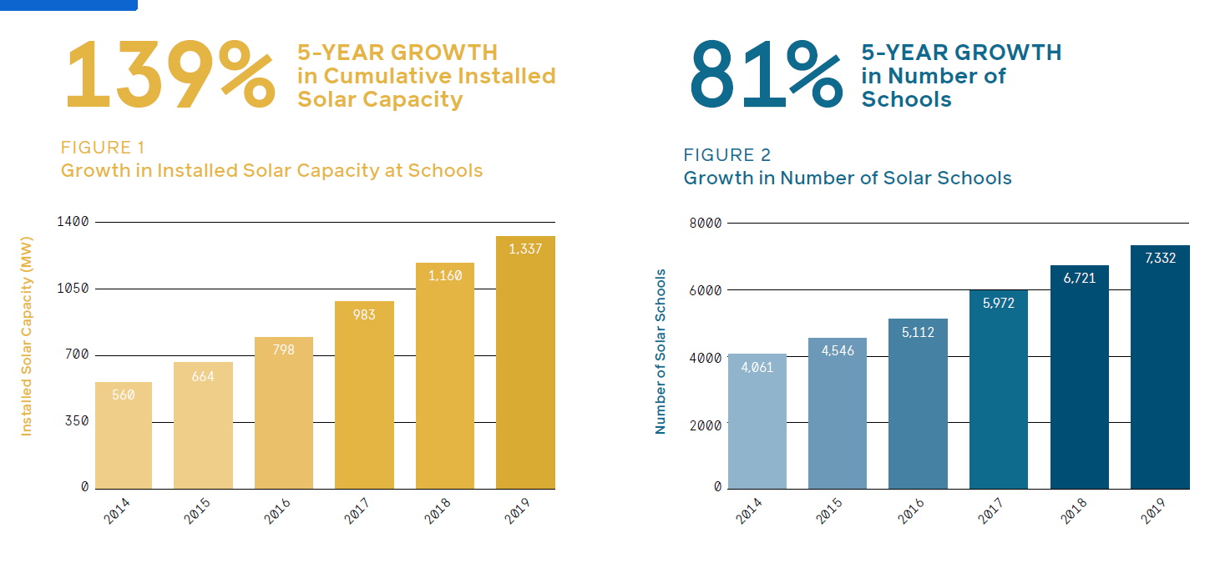
National Solar Schools
Solar schools are generating enough energy to power over 250,000 US Homes each year
Generation 180
Notes:
A national group called Generation180 have put together two solar school reports one in 2019 and one in 2017. The most recent one shows a huge increase in solar schools nationally. Schools are a unique focus for solar because there are so many benefits that come along with solar that are specific to schools.
*read off some of these statistics*

Slide 5
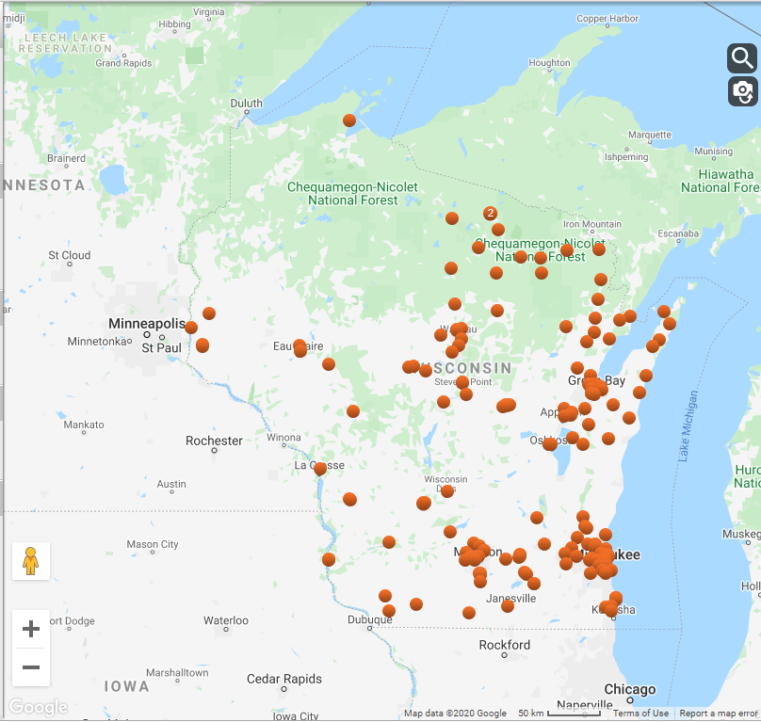
MREA’s Solar on Schools Grant Recipients
Madison West High School
Merton Elementary
Merton Intermediate School
Marshfield High School
Madison College – Reedsburg
Madison College – Fort Atkinson
Forest Edge Elementary School
Northeast Wisconsin Technical College
Midstate Technical College – Stevens Point Campus
Eau Claire Memorial High School
Eau Claire North High School
Milwaukee Area Technical College – Oak Creek
Milwaukee Area Technical College – Mequon
Rice Lake Area School District – High School
Rice Lake Area School District – Middle School
Rice Lake Area School District –Tainter Elementary
Madison College – Truax Campus
Madison College – Watertown Campus
Chippewa Valley Technical College – Eau Claire Campus
Sevastopol School District
Sturgeon Bay Schools: Sawyer Elementary School
La Crosse Area School District – Hamilton Elementary
Wisconsin Solar Schools
Source: RENEW Wisconsin
Notes:
The image on the right shows the current total number of WI school buildings that have solar with the schools on the left listing the solar on schools grant recipients. Schools are increasingly going solar both nationally and in WI. As of 2019 WI had about 125 schools with solar. Based on a 2019 report, Wisconsin ranked 23 of all states with total solar capacity on schools with 4.65 MW of solar at schools – since Solar on Schools started, WI has added 22 more solar schools, and nearly 3.5 MW of solar to that mix in less than 2 years. The tide is changing and it’s time to catch up with the trends AND to save money.

Slide 6
Why School Should Explore Solar
Predictable Occupancy Levels
Most Demand Comes During the Day
School Schedules are Optimized for Large Windows of PV Generation
There is Long-Term Interest in Reducing Utility Expenses
Roofs Provide an Adequate Footprint for Solar
Notes:
Wisconsin public schools collectively spend more than $175 million annually on energy, their largest expense outside of personnel. The dramatic decline in the cost of solar over the last decade has provided schools a unique means to reduce this "fixed" expense without cutting any educational programs. The benefits of solar go well beyond financial savings, however, and have led schools to become leaders in solar development.
These are some of the logistical reasons schools should look into solar – solar makes sense for schools with large, flat roofs, energy use during peak sun shining hours, and energy production during the school day.

Slide 7
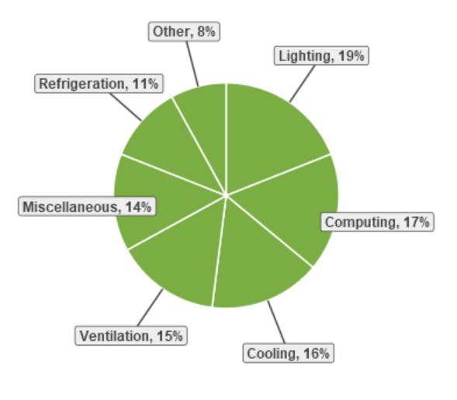
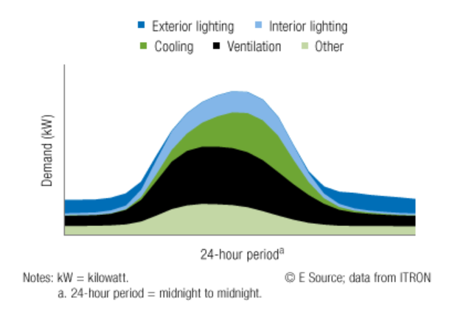
School Energy Use
Lighting, cooling, and computing make up over 50% of K-12 school energy use in the Midwest.
Source: data from the US Energy Information Administration
Notes:
For schools considering installing solar panels, the reality is that any big educational institution will have major utility costs. Nationwide, schools are spending $6 billion a year on energy costs, and WI schools spend $175 million a year -- which is the second largest expense after personnel. A mid-sized school district with 800,000 square feet of space pays more than $1M each year.

Slide 8
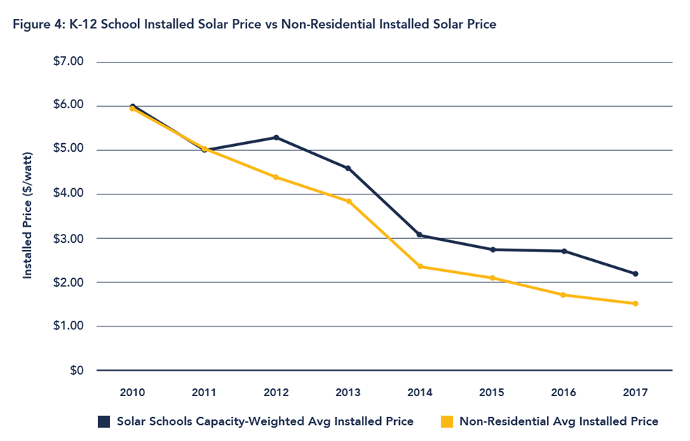
Notes:
WHERE THERE ARE BIG COSTS, THERE IS BIG OPPORTUNITY. There is now a tremendous opportunity for schools to save money and reinvest in students by switching to clean energy– especially since PV systems have dropped in price over 80% in the last decade.
This graph is from a report that was put together in 2017. They show the average cost of a solar school project and compare it to solar costs in general for all projects that aren't on individual homes. It shows that in the last 10 years the cost has come down a LOT. I would compare this to like a new type of phone or computer or video game console that comes out – usually they start off super expensive especially if it's a brand new technology. But over time, the price tends to come down and more people can afford it, right. So the same thing happened with solar here—only it came down WAY faster than folks predicted and way more than folks predicted. In many recent WI solar school sized installations (100-300kW), prices came in well below $2/watt -- at somewhere closer to $1.60 so a 100kW system would cost roughly $160,000.

Slide 9
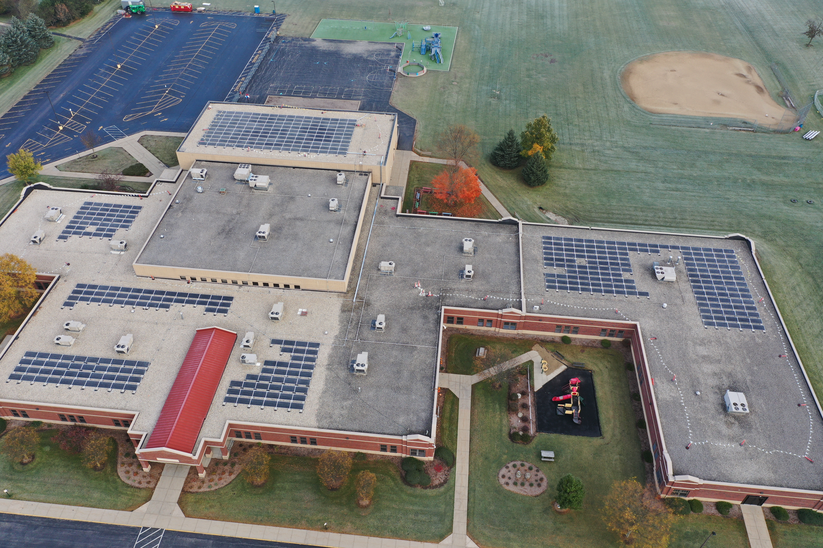
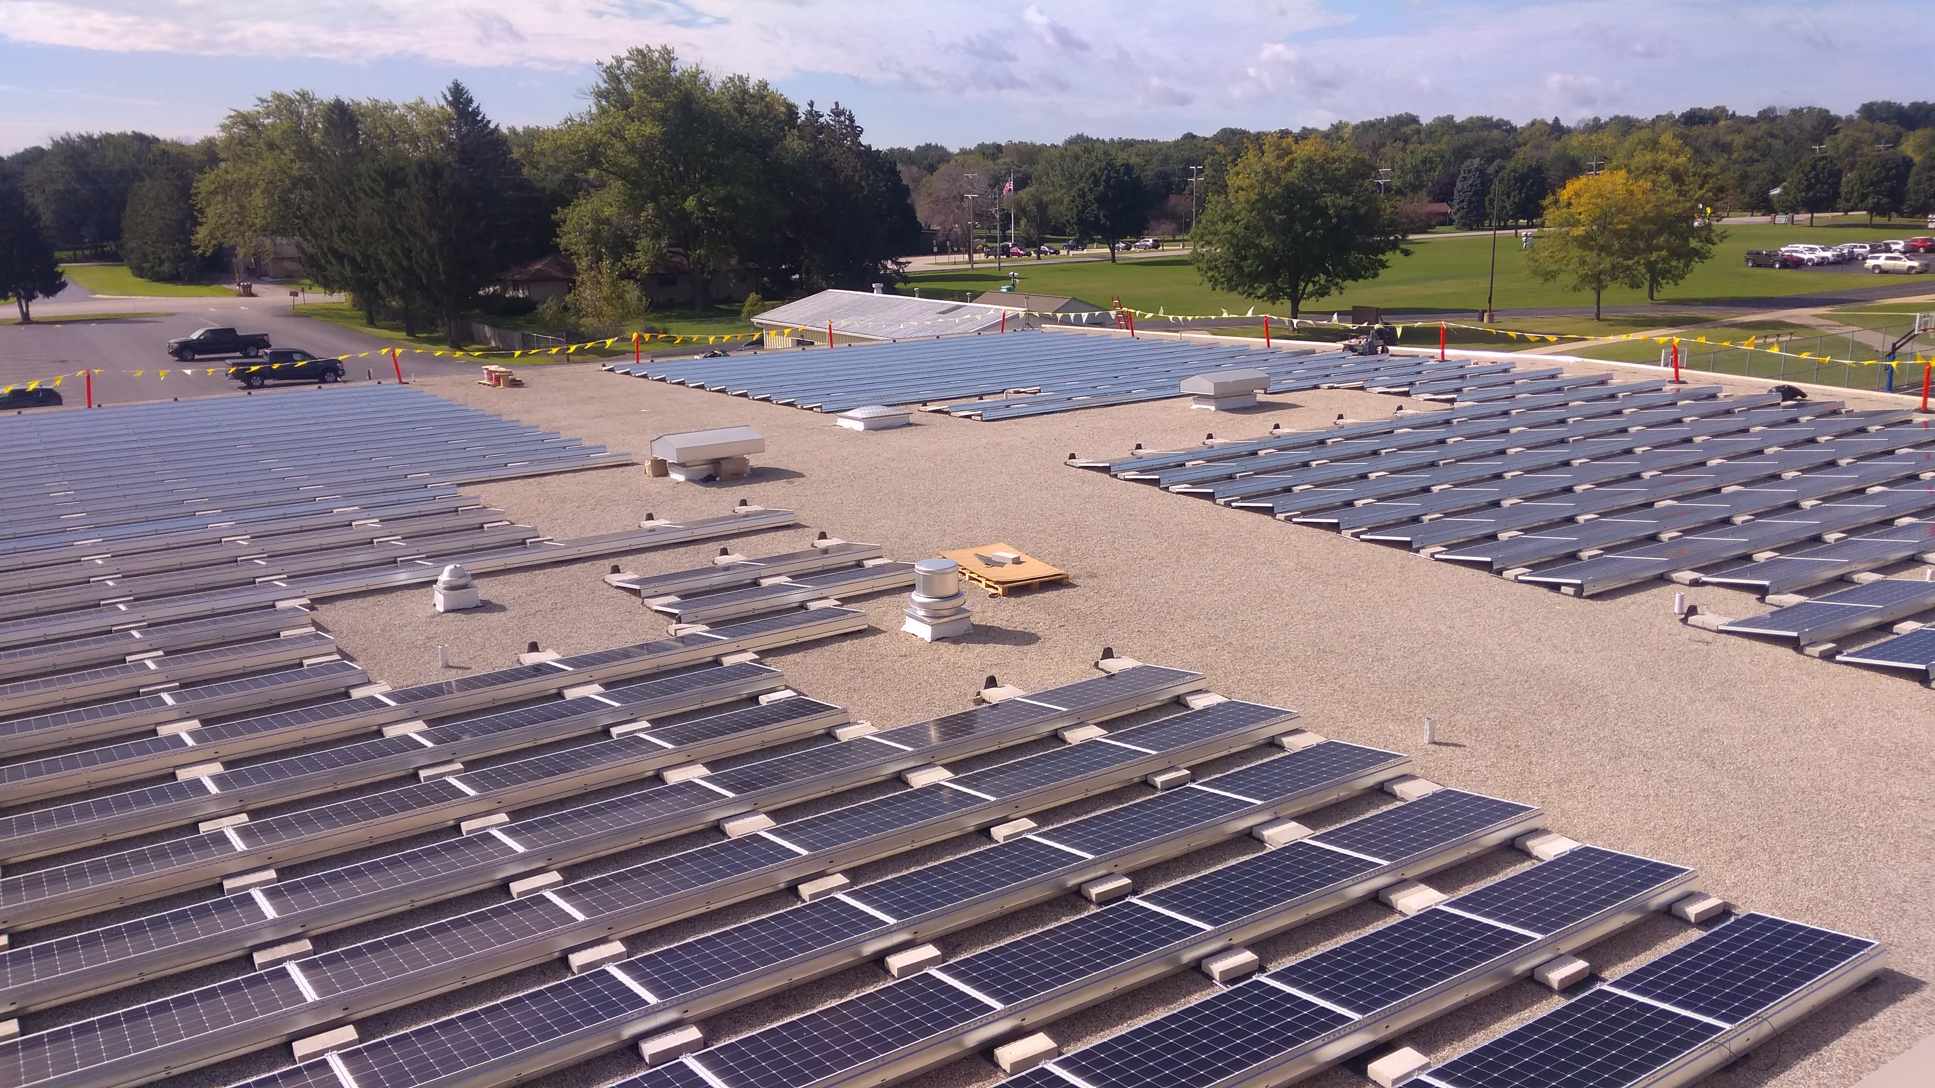
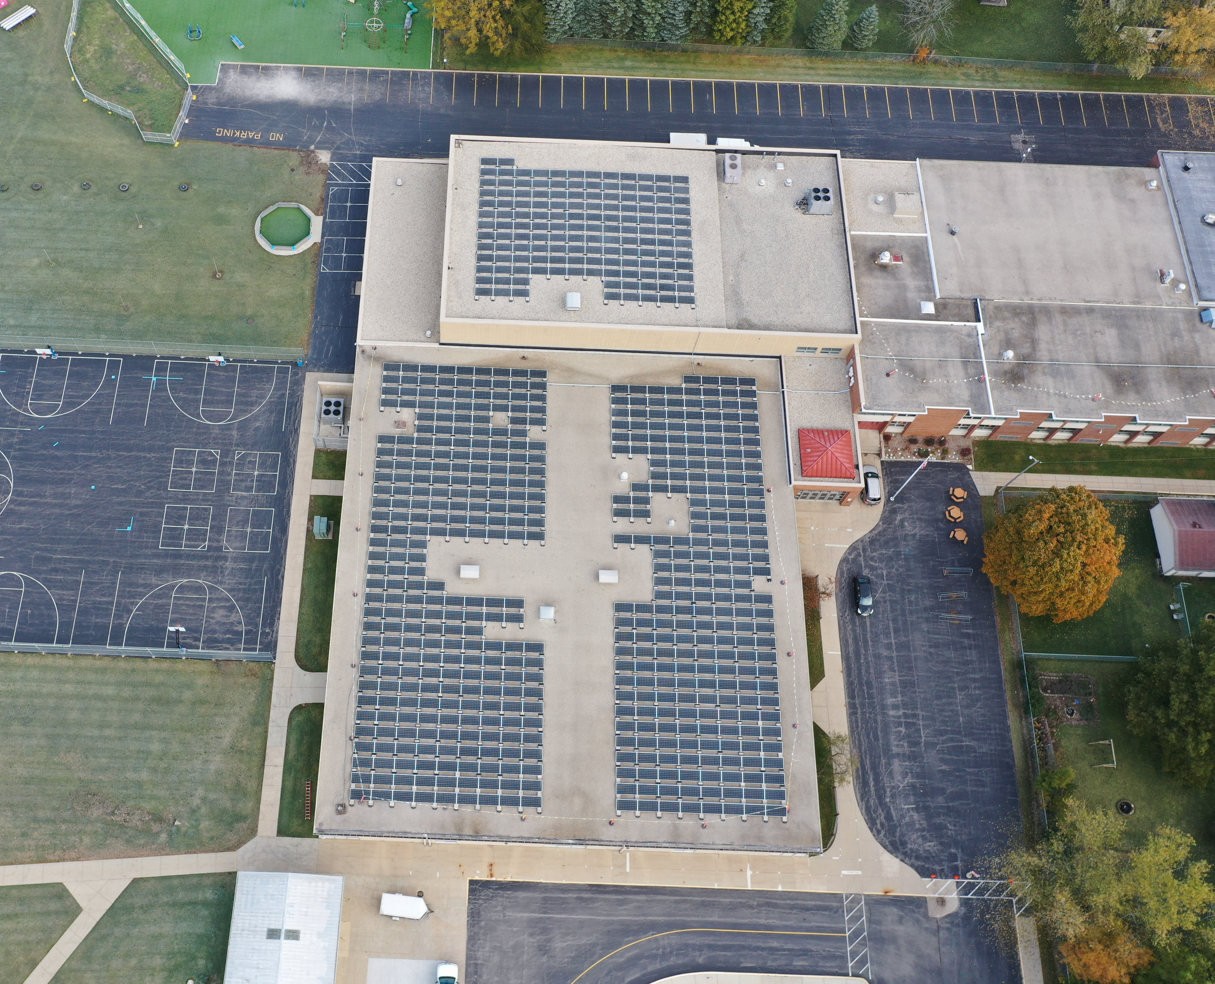
Merton Community School District
Commissioned: December 2019
System Size: 389kW DC
Expected Year 1 Performance: 491,120 kWh
Racking: Ecolibrium Ballasted Non-Penetrating
Modules: Adani 72 Cell Tier 1 355W
Inverters: SolarEdge + DC Optimizers
Monitoring: SolarEdge Consumption + Production monitoring
Solar Installer: SunVest Solar Inc.
Total System Cost: $568,185
Value of Grants & Incentives: $108,182.28
Cost/Watt: $1.46
30-Year IRR: 10.3%
Average Annual Savings: $70,000
30 Year Cashflow: $1,419,921
Notes:
Let’s look at a local example of a school that went solar and saved money:
Merton Community School District went solar because they were trying to save their school district money. They'd already done some energy efficiency things like changing all their light bulbs to LEDs. Then, in the Spring of 2018, a School Board member was pursuing their own solar energy for their home and brought the idea of solar PV to the district as a means to save on operating expenses. The School Board and Village Hall met several times to run numbers and build capacity through the Winter of 2018 and received some early calculations from SunVest (an installer) which showed great potential. The district formally went to bid (asked for formal cost estimates) for the solar project in March 2019 and by December, the 389 kW DC solar array was installed, commissioned, and online.
The Merton Community School District invested in solar energy as a way to continue to save energy which means we are contributing to a cleaner environment as well as saving money. This system is projected to cover 2/3 of their electricity needs – saving them an average of $70,000 each year!
This also shows they were able to secure over $100k in grants and incentives, paid about $1.46/watt for the system, and will save over $1.4 million over 30 years. These are funds that can be reinvested into US, the students, through extracurricular activities, technology upgrades, or even hiring a new teacher.

Slide 10
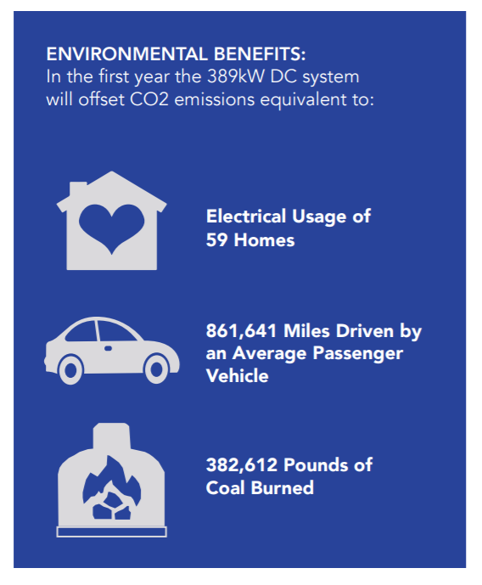
Merton Community School District
Notes:
Merton paid for most of the system through a low interest loan (about $500,000) and throughout the duration of the loan, they are remaining cash flow neutral (meaning their loan payment is equal to how much they’re saving during the time period they’re paying off the loan, which is 10 years) and this was with conservative modeling estimates.
This is a school in a financially conservative district in Waukesha County and they pursued solar for the financial savings it allotted them—allowing to cut some of their operating expenses after they did some energy efficiency upgrades.
Discuss environmental benefits – the system produces enough energy equivalent to the greenhouse gas emissions ANNUALLY of electrical usage of 59 homes, 861,641 miles driver by an average passenger vehicle, or 382,612 pounds of coal burned. So NOT ONLY can our school save money – but we can reduce our carbon footprint at the same time.

Slide 11
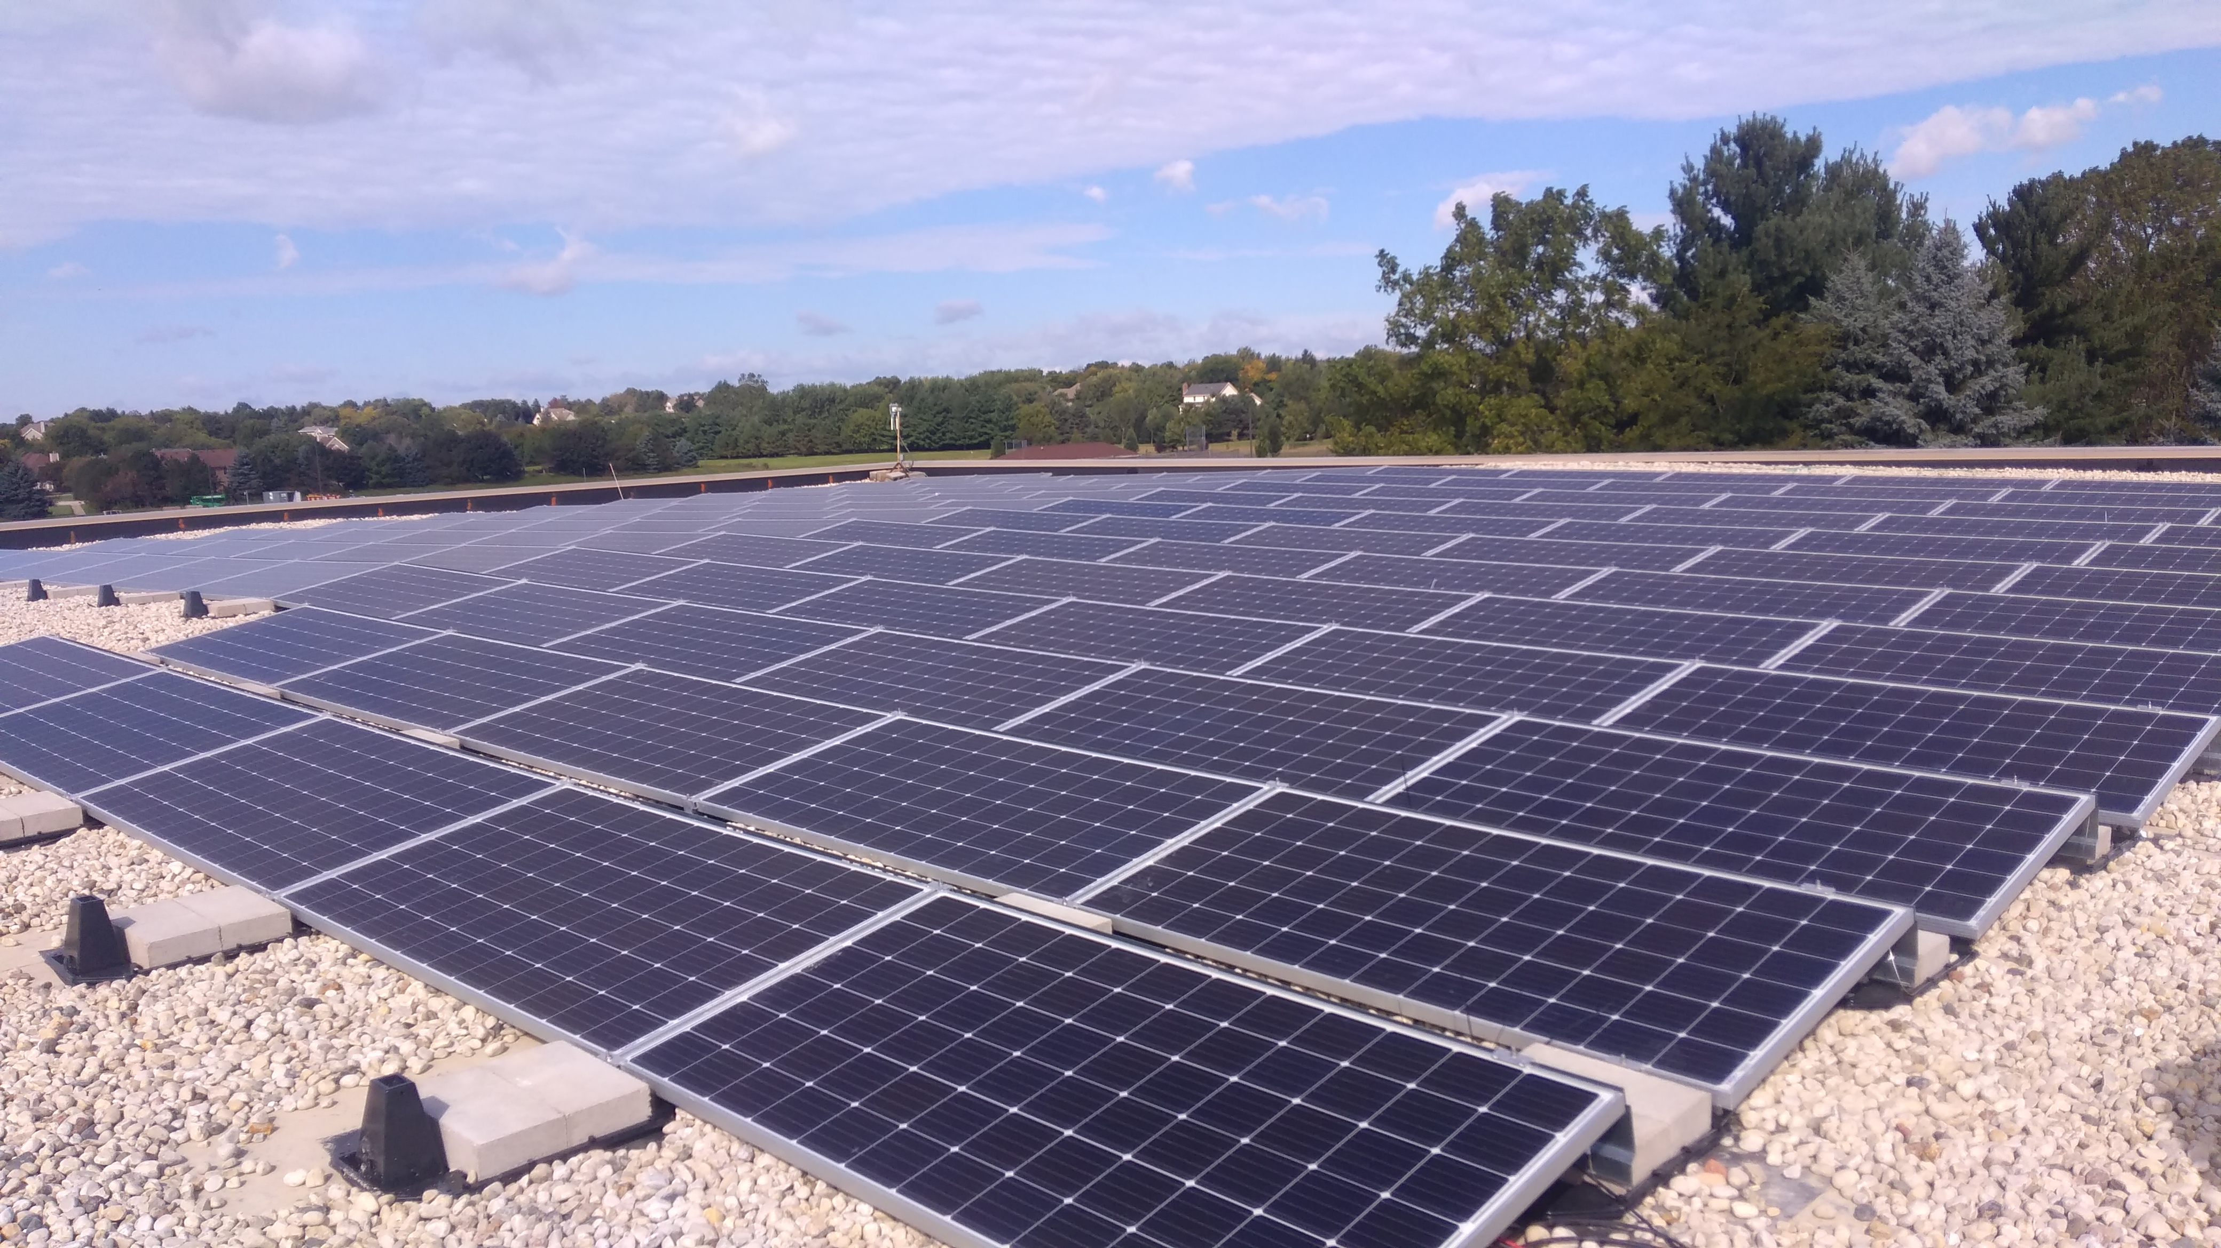
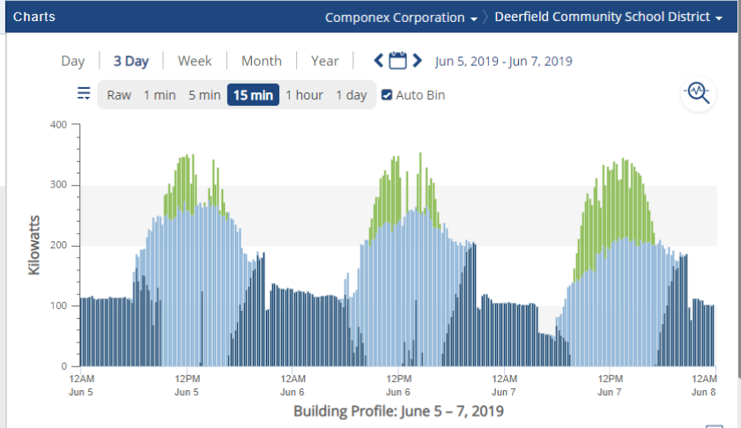
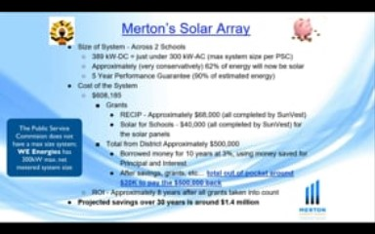
Notes:
We know that every school and every project is a little different and needs to be tailored to each school's wants & needs. Things like system size, financing, system location, and even curriculum should be thought about early on.
Through MREA’s Solar on Schools program, they’ve put together solar school case studies of the different solar on school grant recipients providing technical and general information about each project at midwestrenew.org/solar-on-schools. These can help us learn from what other schools did, what their process looked like, and how much money they’ll save.
Don’t just take our word for this thought – listen to the Merton School District Superintendent, Ronald Russ talk about their process of going solar. [play video]

Slide 12


Solar Energy at Schools, Cities, Other Public Entities
80 Iowa communities currently have solar
Average annual savings: $26,475, as high as $80,000
Average lifetime savings: $716,437
$375+ million saved if all cities, counties, and school districts installed the average system
"Figure out a way to do it because […] the benefits both financially and environmentally are there. Do not look at just your roof tops, but make sure you consider ground space as well."
-Black Hawk County, IA
auditor.iowa.gov/pie/pie-reports/
Notes:
Full report: https://www.auditor.iowa.gov/media/cms/IowaSolarReport_55192DA30BB49.pdf
The Iowa Auditor of the State recently conducted a report on solar at schools, cities, and other public entities. Local entities that were inteviwed, describe their solar energy programs as cost-effective, environmentally sound and a source of pride. In one school district, the savings equaled a teaching position. In another, the savings allowed the district to keep the school open and avoid consolidation. Cities like Knoxville teamed up with their school district for joint savings, freeing up dollars in the General Fund for other uses. Mason City calls its solar program a “win-win” by reducing its carbon footprint and operation costs.
This report showed that the average system savings was over $26,000/year and if all of the public entities installed solar, these projects would result in over $375 million dollars in savings.

Slide 13
Benefits of Solar for our School
Financial Considerations
Environmental Benefits
Community Engagement
Emergency Response & Resilience
Job Creation
Educational Opportunities for Staff & Students in STEM Fields
Student-Led Action
Notes:
Wisconsin public schools collectively spend more than $175 million annually on energy, their largest expense outside of personnel. The dramatic decline in the cost of solar over the last decade has provided schools a unique means to reduce this "fixed" expense without cutting any educational programs. The benefits of solar go well beyond financial savings, however, and have led schools to become leaders in solar development.
Schools are community centerpieces, so when one school goes solar, other schools pay attention and the entire community learns about solar collectively. Solar is really contagious and we want our school to be a leader instead of a follower.
We also know that this is a really good opportunity for us students to learn about clean and renewable energy with hands-on curriculum and activities related to the solar. These experiences will expose us to interests and careers in the industry that we may not otherwise consider.

Slide 14
U.S. Solar Industry Employment Increased by more than 73,000 in 2016 – a 25% increase
WI employers anticipating adding more than 6,000 clean energy jobs in 2019 – an 8.4% growth.
WI employs almost 4000 people in solar with over 75,000 in clean energy jobs overall, 2.5% of the total labor force
Renewable energy employs 6,000 people in Wisconsin, a 5.4% growth from 2017.
Job Creation & Educational Opportunities
Source: CleanJobsMidwest.com
Notes:
Installing solar onsite allows schools the opportunity to provide hands-on education, promote student leadership experience, and facilitate career exploration for students in renewable and clean energy.
Being able to see the energy production in real time and calculate the energy savings engages curious young minds like ours. How do the solar modules produce electricity? How does cloud coverage impact energy production? Is it necessary to scrape the snow off the system in winter? These experiences will help us and future students become excited about clean energy career opportunities. And if the next few decades of energy development unfold like we expect, the Midwest will need every skilled and dedicated professional we can attract.

Slide 15
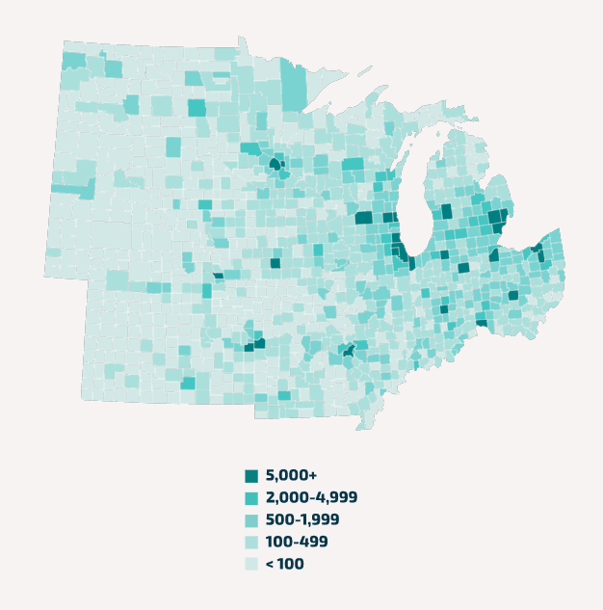
The clean energy industry represents one of the fastest growing career fields in the United States, adding jobs 70 percent faster than the overall economy from 2015-2019. Prior to COVID-19, the industry employed nearly 3.4 million Americans, more people than worked as schoolteachers and three times as many that worked in fossil fuels.
Notes:
These clean energy jobs are well-paying, career opportunities with a demand that is only going to grow as our national energy economy continues to transition from fossil fuels. By investing in solar, passing 100% renewable energy resolutions, integrating energy education into curriculum, and cultivating the next generation to be leaders and have careers in the industry, schools can lead their communities into a clean energy future.

Slide 16
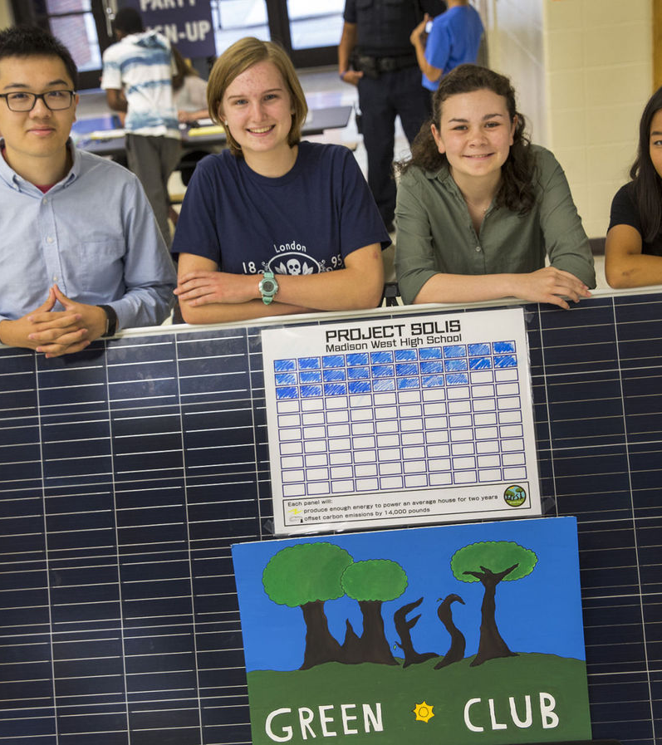
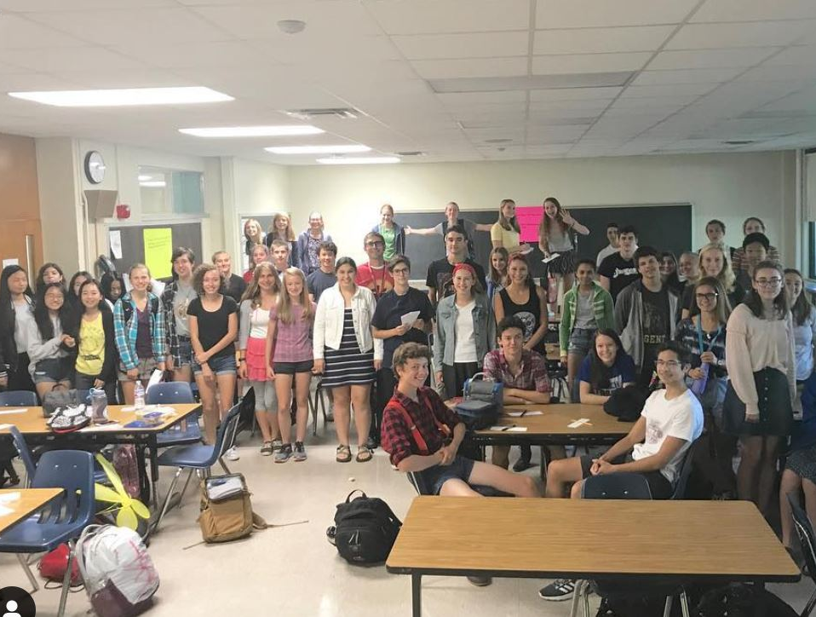
Madison West High School Green Club
Notes:
The Madison West Green Club raised over $80,000 to help their school install solar which finally happened at the end of 2020, a 125.8 kW system (case study). The district has also passed a 100% renewable energy resolution, went to referendum for a facilities budge that includes funding for sustainability projects, and is actively pursuing new opportunities.
We’re prepared to provide leadership, and assistance with the project development as needed, just like Madison West students did. We’re passionate about moving a project forward.

Slide 17
The Case for Solar Schools: FAQs
Materials
System Size
System Cost
Lifespan & Warranties
Energy Production & Financial Savings
Net Metering
Roof Considerations
Snow Considerations
Maintenance
Insurance & Damage
RFP Considerations
Notes:
We’ve also done our research – there are a lot of commonly asked questions that schools think about when first considering solar, so we wanted to go over some of this information preemtively with you all.

Slide 18
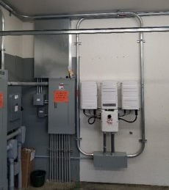
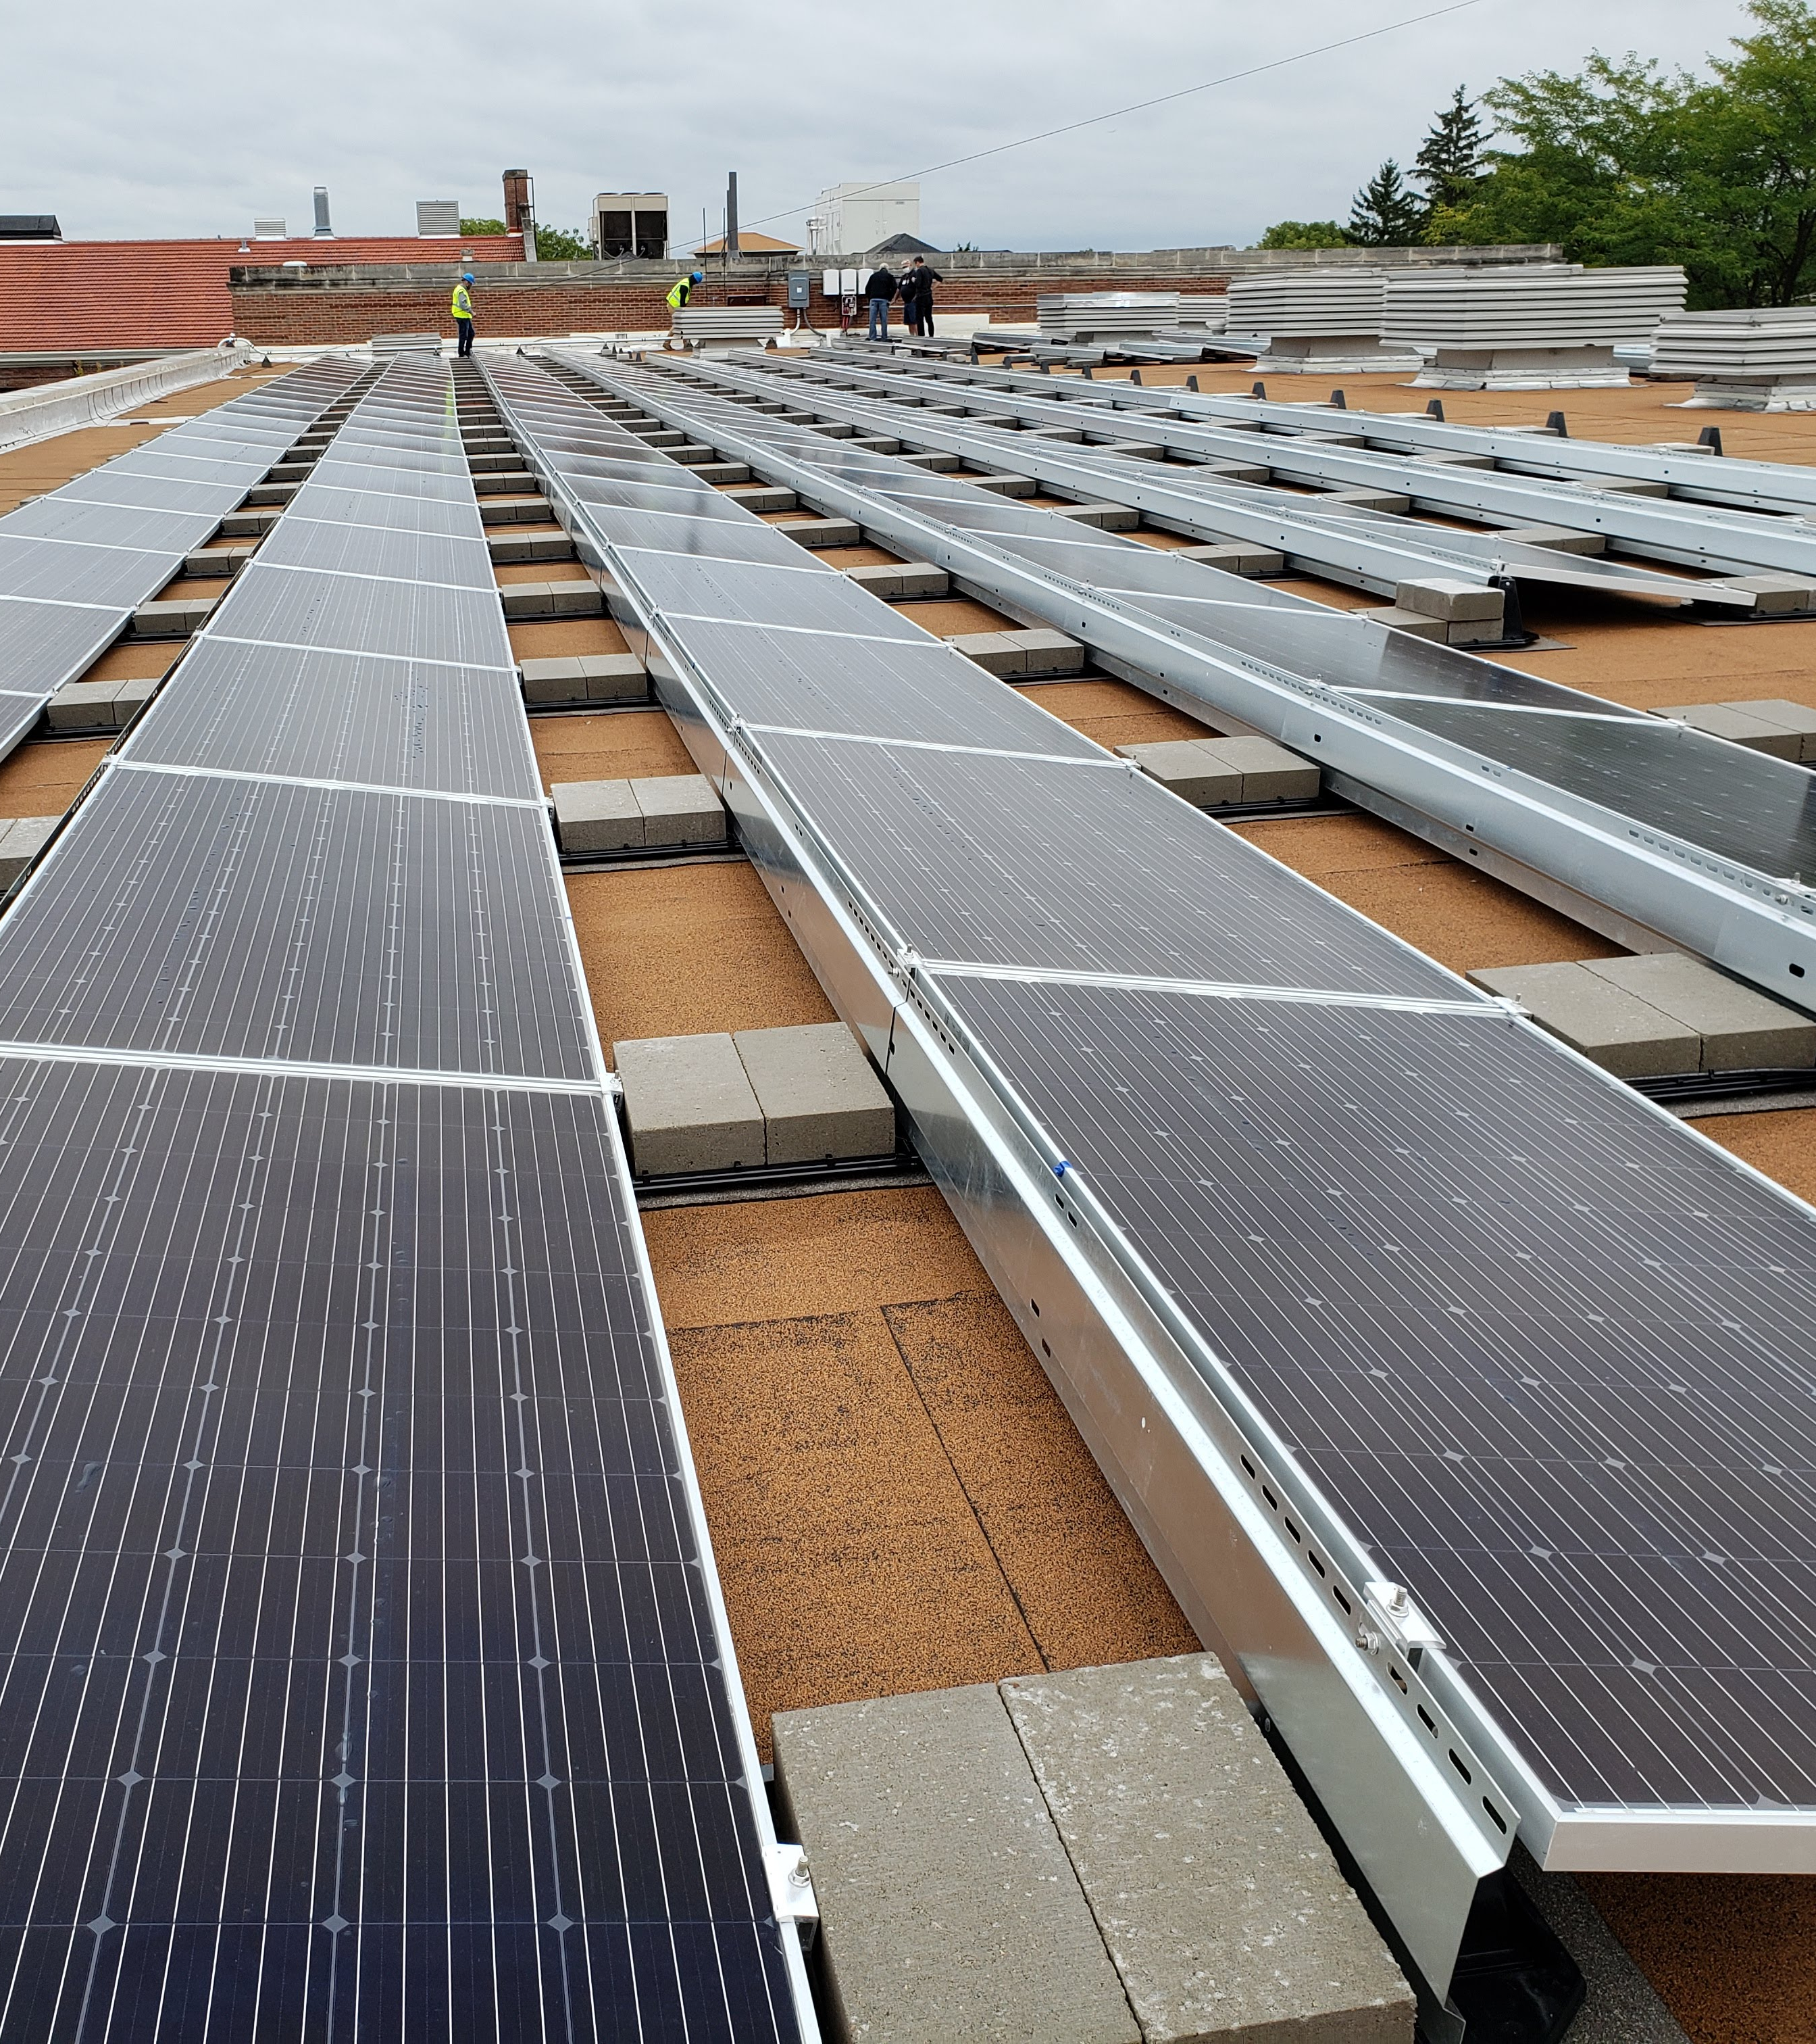
What are the components of a solar PV system?
Notes:
Solar panels: Also called solar modules, these are the door-sized components that collect the sun’s energy, creating DC energy. Modules are rated at how much energy they can individually produce under ideal conditions. Currently, modules are commonly rated starting at 300 watts and reaching around 450 watts apiece.
Racking: This is the collection of components that hold your PV modules and system together and attach it to your roof or the ground. Rack designs vary depending on if your system is ground-mounted, on a flat roof, or on a sloped roof.
Inverters: These take direct current (DC) power from the solar panels and invert it to alternating current (AC) power, which is what most of our appliances and systems run off.
Balance of System (BOS): This includes every other electrical component of the system such as wiring, conduit, combiner boxes, switches, circuit breaker panels, and more.
Battery: Batteries are not yet common on most solar school installations. However, as the price of batteries decreases, they are drawing more interest. Batteries can provide backup power in the event of electric utility outages, and they would allow us to maximize our system’s energy production- the Oregon School District new elementary school, Forest Edge Elementary uses battery power with a large solar PV system and geothermal heating to become the first net zero energy school in the state (produces as much energy as it uses annually).

Slide 19
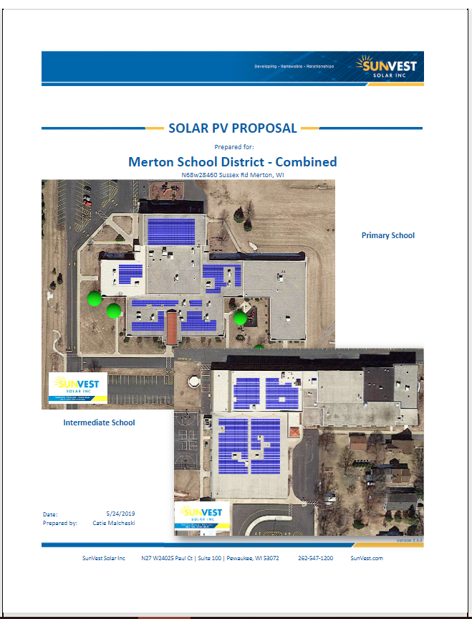
How much will the system cost?
Notes:
A typical school-sized PV system (100 kW – 300 kW DC) will cost less than $2 per watt (as of 2021), often at $1.50-1.60 per watt. For example, a 100 kW DC sized system would likely cost less than $200,000. You can use these estimates when estimating how much various system sizes will cost. MREA's Solar on Schools page has put together case studies for the recent solar on schools projects that includes the sizes, system details, and costs for each so you can compare and see what to expect for a cost.

Slide 20
Energy Production
100-kW system on a flat school roof produces about 130,000 kWh annually (more with bifacial modules)
If you pay $0.09/kWh, you can estimate an average savings of $11,700
Notes:
We can calculate this for our specific location at PVwatts.nrel.gov.
Any installer will do a more detailed analysis of savings by looking at things like any shade issues, how our utility will credit us for excess energy produced, demand charges, and more. But Pvwatts gets us a rough estimate.

Slide 21
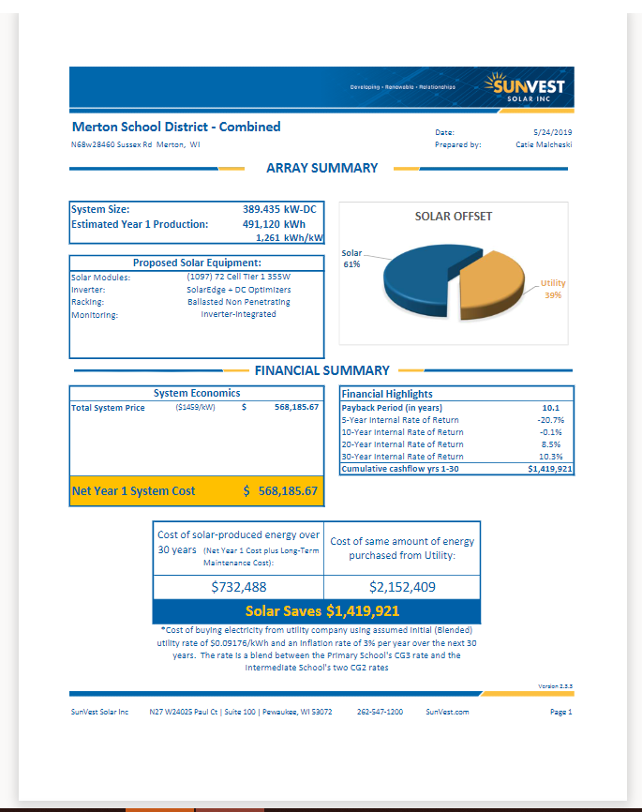
How much can I expect to save on my electrical bills from my PV system?
Notes:
Internal Work: If you want to do some of these calculations yourself, a good place to start is using PVwatts.nrel.gov to determine an approximation of how much energy your system will produce in one year. A rough estimation of savings will be what you pay per kWh multiplied by the estimate of the annual energy production of your system. To fine-tune this estimate, you can use resources such as SolarProjectBuilder.org or System Advisor Model.
External Work: Alternatively, you can hire a consultant or work with a contractor prior to going out to bid (if you are able to do so). They can provide much of this information through site assessments and financial modeling of various system scenarios. RENEW Wisconsin currently offers a matching grant to cover 50% of a site assessment through their partner. A lot of schools get these site assessments and preliminary proposals to use as a starting point to decide whether or not to move forward into planning a project.
Either way, this modeled financial savings depend heavily on access to net metering rates, demand charge savings, and other policies which vary widely by utility. Any consultant or installer will know the policies of our local utility.

Slide 22
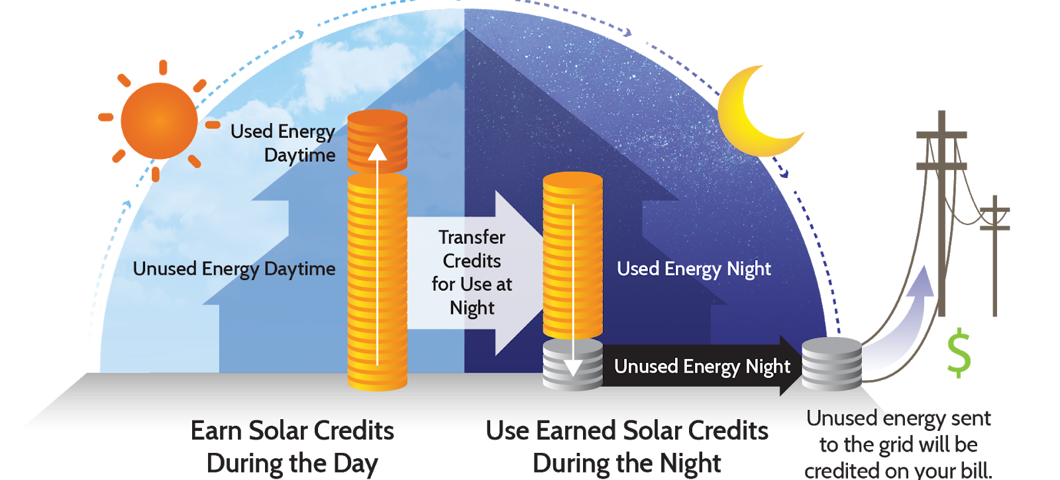
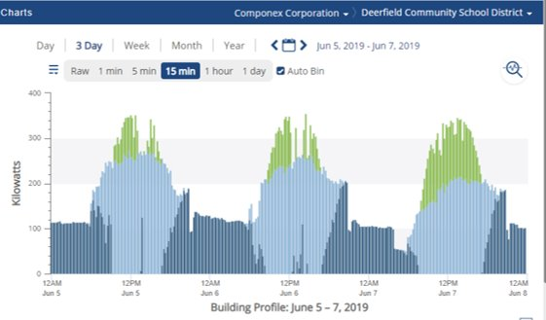
How does my utility credit me for energy our system produces?
Notes:
If you use the energy you produce instantaneously, your utility does not need to credit you for anything. If there are times when the PV system is producing more energy than the school is consuming, then the excess energy will go back onto the grid and power your neighbor or someone else’s nearby electrical needs. In many cases, you can be credited for this energy production that you send back to the grid. This is called net metering, and in Wisconsin, is typically limited to PV system sizes up to 20 kW, 100 kW, or 300 kW, depending on the electric utility.
If you do have access to net metering, this can be credited to you at the retail rate (what you pay for electricity), at a wholesale rate (typically 3-5 cents/kWh), or other rates as specified by the utility. It is important to consult with your solar installer and electric utility to determine net-metering policies for your school, since this will likely impact your ideal PV system size. In some cases, you may be able to set up a unique negotiated arrangement for your system, such as getting credit for summer production if your school is not in session at that time (most common with municipal utilities).

Slide 23
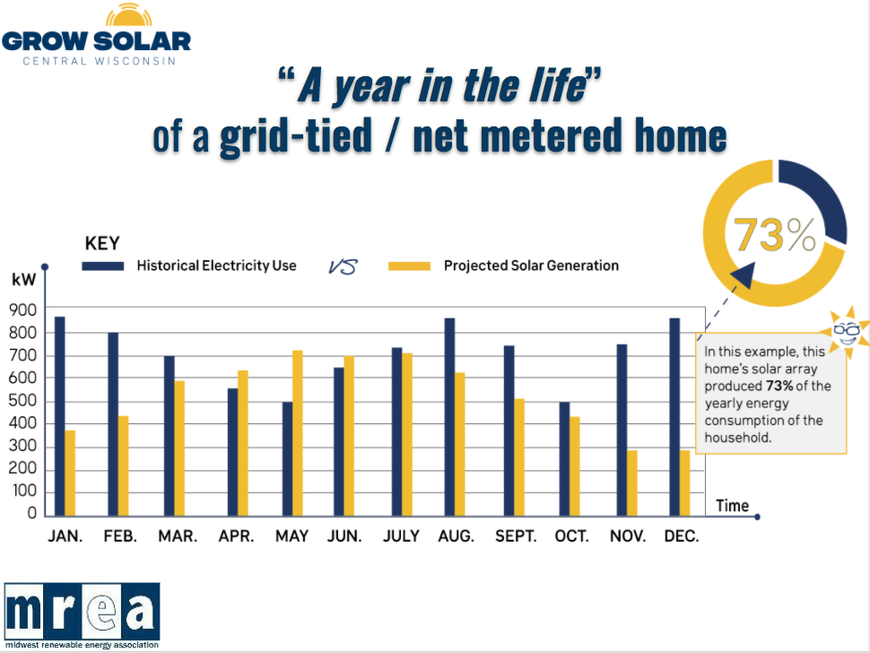
How do we determine our ideal solar PV system size?
Is your goal to offset as much of your energy use as possible?
Are you limited by roof/other space?
Are you limited by funding?
Do you want to maximize your ROI?
Notes:
Is your goal to offset as much of your energy use as possible? A key place to start is by looking at your energy bills and determining how much energy you consume annually. Ideally, you’ll want to average out 1-3 years’ worth of data (and consider any energy efficiency upgrades that will reduce your consumption in the future). You can use PVwatts. nrel.gov or work with your solar installer to help determine an ideal system size that will produce all or a portion of the energy that your building consumes. Additionally, you may want to consider adding batteries to your system to store excess energy produced, or at least design the system to be battery ready so that you have the option to add them when prices come down in the future.
Are you limited by roof/other space? You’ll want to work with your installer to calculate the space available for solar. You’ll need to consider any mechanicals that are on your roof. Current rooftop racking designs typically accommodate about 15-20 Watts of PV per square foot of roof space. However, this number is dependent on the panel type, orientation, tilt angle and inter-row spacing. Furthermore, this rule of thumb number has been inching upwards as the capacity of modules (how much energy they can produce per module) increases each year.
Are you limited by funding? In recent years, school sized solar installations (100-400 kW DC) in the Midwest have been completed for below $2/watt, often at $1.50-1.60/watt. For example, a 100 kW DC sized system would likely cost less than $200,000. You can use these estimates to help determine your ideal system size.
Do you want to maximize your Return on Investment (ROI)? This can depend on many factors including your electricity tariff, the availability and type of net metering, grants or other incentive payments, and the type of financing used for the project. If you will not have access to net metering, it may be ideal to size your system to offset only a portion of your annual electricity consumption (30-60%) to make sure that the PV system is never producing more electricity than you’re using at any given time.

Slide 24
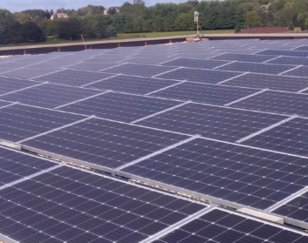
What do I need to know about my roof and solar?
Age Considerations
Roof Penetrations
Weight Considerations
Solar Impacts on Roof Quality
Notes:
Age Considerations: Solar is suited best for new or fairly new roofs. Contractors typically model PV systems for 25-30-year time horizons. Twenty-five-year module warranties have become a de-facto industry standard, and they typically guarantee that panels will still produce 80% of what they originally did at the time of purchase. If there are no suitable roofs available or soon to be available, ground mounted systems are comparable in price, and can provide quicker snow shedding and extra production when using bifacial modules – check if we have vacant land available.
Roof Penetrations: If you install solar on a flat roof (most common for schools), the modules are typically held onto the roof using concrete ballasts (stone blocks) to weigh them down, or stone ballast (the existing rocks on top of roofs) from the existing roof. These types of installations often require no new roof penetrations. You and your solar installer can consult with your roofing company to make sure the PV installation is in compliance and does not void your roof warranty.
Weight Considerations: Weight-bearing capacity can vary widely from roof to roof, and it is common for a flat-roof ballasted PV system to weigh 3-7 pounds per square foot. A structural engineer will be required to confirm that your roof can handle the additional weight. If there is existing stone ballast on the roof, it is generally possible to remove a portion of the stone to accommodate the additional weight of the solar array.
Solar Impacts on Roof Quality: Solar PV systems tend to protect the quality of the roof. The shade from the system can slow down aging due to weather and ultraviolet light. Also, pieces of rubber membrane, or slip-sheets, are located between the base of the racking and the existing roof, protecting it from any wear and tear. However, it is important to minimize foot traffic on the roof and lay down extra roof mats to protect the roof in high traffic areas. This is important to consider if you plan on making a portion of the system available to students or others for tours.

Slide 25
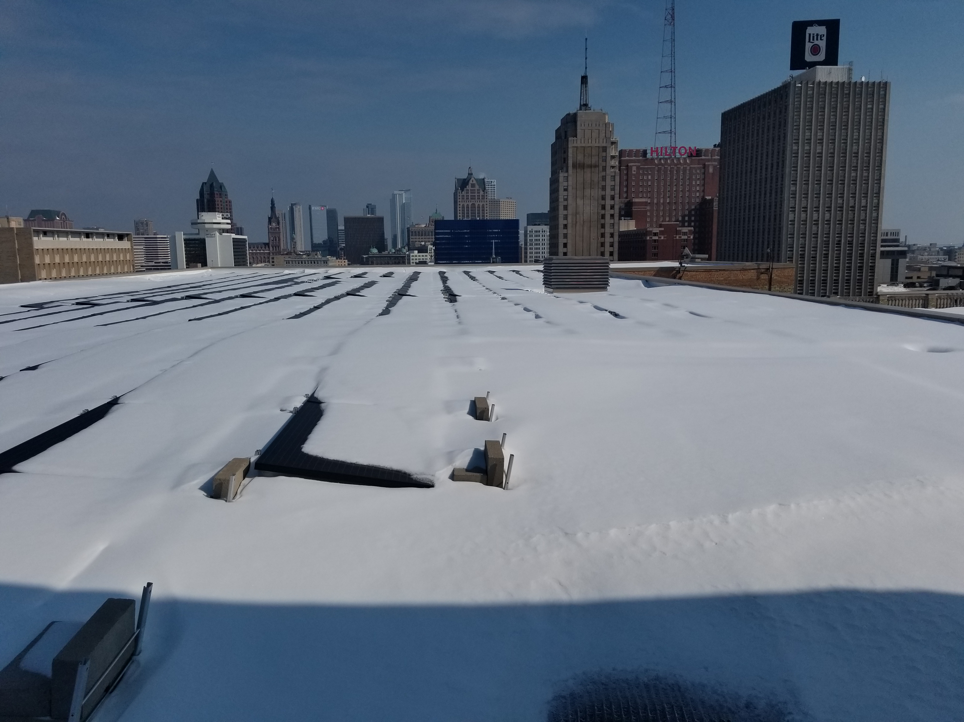
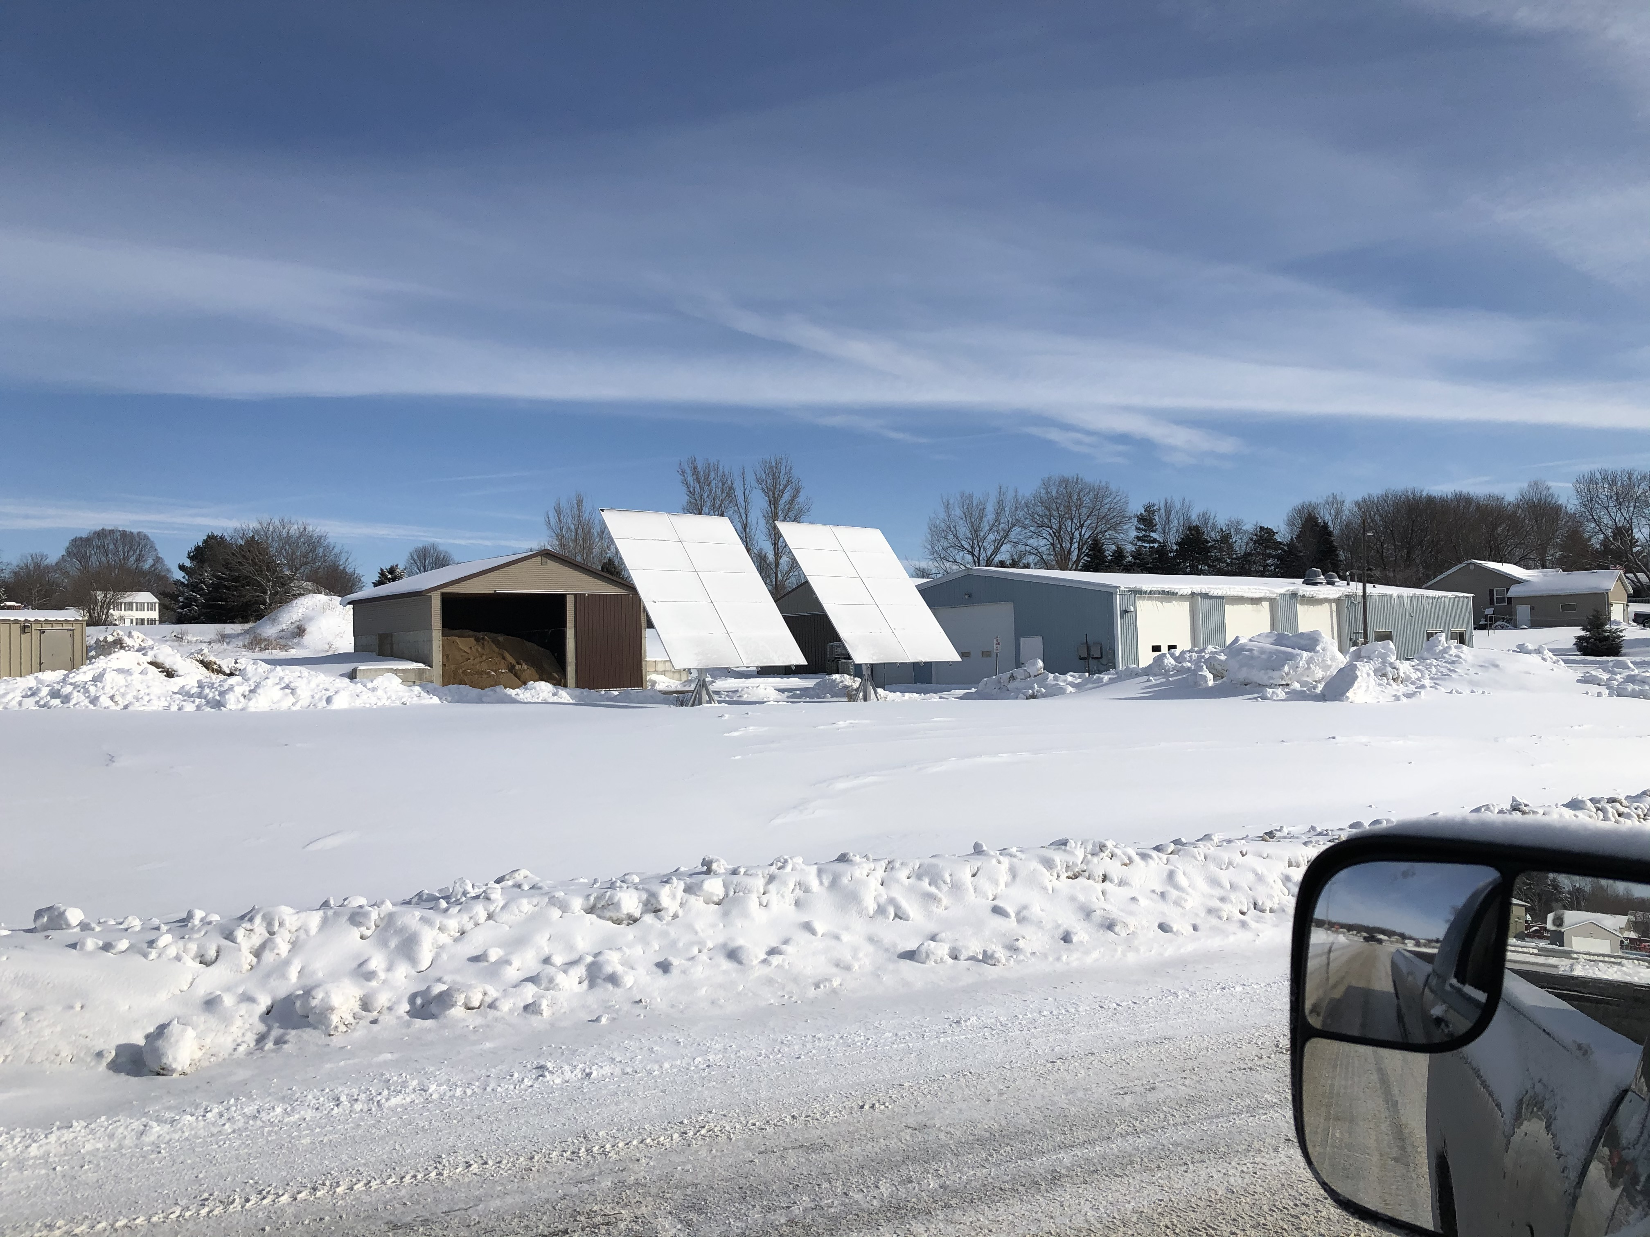

What about snow??
Natural snow shedding
Flat roof ballasted systems are typically installed at 10 degrees
Bifacial panels shed snow quicker and provide increased energy production
Ground mounted systems are installed at steeper angles: 40-60 degrees
Notes:
You don't have to shed the snow off of your modules. The sun will warm the backside and eventually, usually within a day or two, the snow falls off. It is most often not financially lucrative to pay someone to go up and scrape the snow off the roof. If you have open land available, bifacials are an excellent option for ground mounted systems where you can close them at 40-60 degrees, helping them shed snow faster in the winter and start producing energy again.

Slide 26
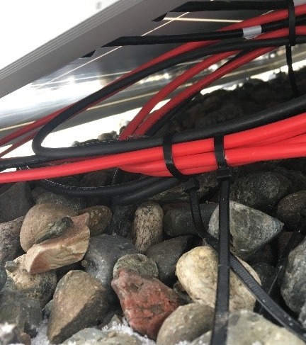
What kind of maintenance is required for these systems?
Notes:
Solar without battery storage requires little maintenance. You do not need to brush off the snow or clean the modules from soot or dust. Production losses due to snow cover and dirt should be included in the power generation estimates provided by your installer. In fact, the rain and snow tend to help keep the modules fairly clean.
It is recommended to inspect the system once annually, looking for loose wiring or modules or other pieces that aren’t working properly. If you have small staff, have personnel that are already stretched thin, and/or are worried about maintenance requirements, you can include maintenance services in your solar Request For Proposals (RFP) and in the subsequent solar installation contract. Cost of maintenance can be estimated to be 0.35% of the system’s installed cost each year, and contracts can be implemented for durations ranging from a single year up to the expected life of the system. Any mechanical errors usually occur almost right away, that is when the workmanship warranties come in handy.

Slide 27
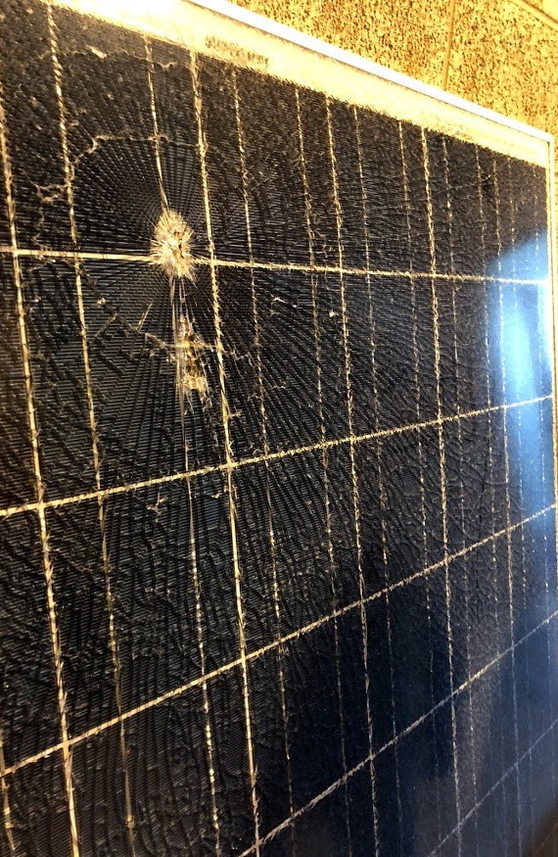
What if something breaks?
Will my insurance cover damage to the system?
Notes:
These systems are modelled to last 25-30 years, but often can continue to produce energy even after 30 years. Although failures are quite rare, there are times where a module or another component of the system has issues, and these components will need to be replaced. Performance warranties, product warranties, both (for modules and inverters), help ensure the replacement of any faulty components. The glass on a solar panel is tempered glass and is rated at minimum to take a 1-inch hailstone at 50 mph.
A performance warranty is a guarantee that the module will continue to work as stated for a specific period of time, Typically, the energy production of a PV module decreases by about 0.5% each year. So even after 20 years, the panel will still produce roughly 80% of what it did when it was originally purchased.
For example, it would guarantee 80% production after 20 years.
Product warranties: covers the integrity of the panel itself and protects you against problems such as manufacturing defects, environmental issues, premature wear and tear, etc.
Workmanship warranties vary in detail (we’re told you should read the fine print on what they cover!) but they tend to guarantee function of the system in relationship to its design:
The design, assembly and installation are all done correctly
The system will perform as expected, without malfunction
Any defects that may arise will be fixed free of charge
Inverter warranties range from 5-12 years and the cost of inverter replacement at 12 years is most often figured into financial models and payback calculations.
Insurance: Consult with your insurance company early on to determine if you need to expand your coverage. Typically, existing insurance will cover the PV system in the case of external damage. If you need to purchase additional insurance, you can estimate it will be 0.35% of the system’s installed cost each year.

Slide 28
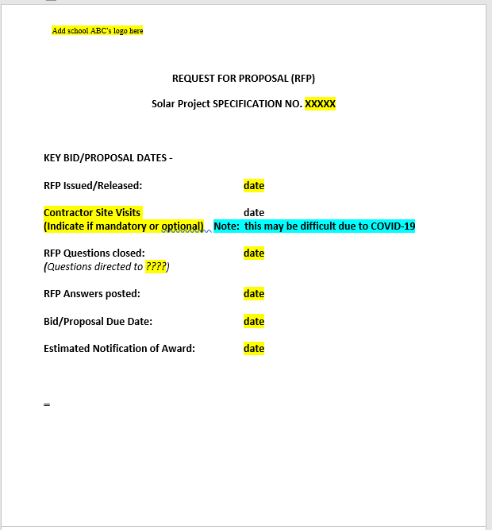
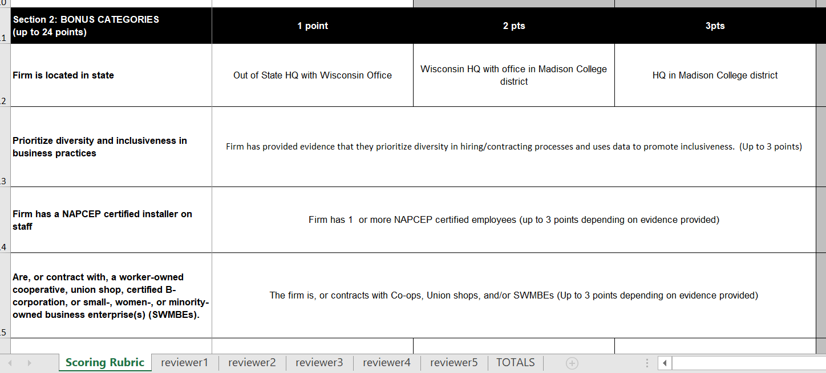
RFP Development and Bid Evaluation
Notes:
Base Bid Requests: Ideally you want to dictate a specific system size and site location, among other considerations, so that you can compare apples to apples. You can always openly ask for alternate bids which are open to a change in things such as system size, location, ROI, and other details. This allows the contractors to use their expertise to design a system ideal to your location and needs.
Technical Considerations: There are a few technical considerations you may also want to include in your RFP including the location of the PV array, balance of system components, and utility disconnecting means. A good place to start is with the Solar on Schools RFP template available through CREATE’s Solar on School’s Toolkit or MREA’s Solar on School’s online Resource Center. This template is intended to be used as a starting point document that a school can edit, revise, and add or delete details as needed.
Educational Considerations: It is important to include any curriculum requirements into the design process and RFP early on. Do you want access to the system for students or tours? What safety considerations should you have in mind? Do you want the contractor to provide training to teachers or give a presentation to students? Do you want solar dashboards made available within certain classrooms or the hallway? Contractors aren’t necessarily used to designing systems with educational components in mind, so make sure you ask for what you want.
A lot of this information was gathered from Getting Solar at Your School: FAQs prepared by the MREA (https://www.midwestrenew.org/wp-content/uploads/2021/01/FAQs-SOS-5.pdf)

Slide 29
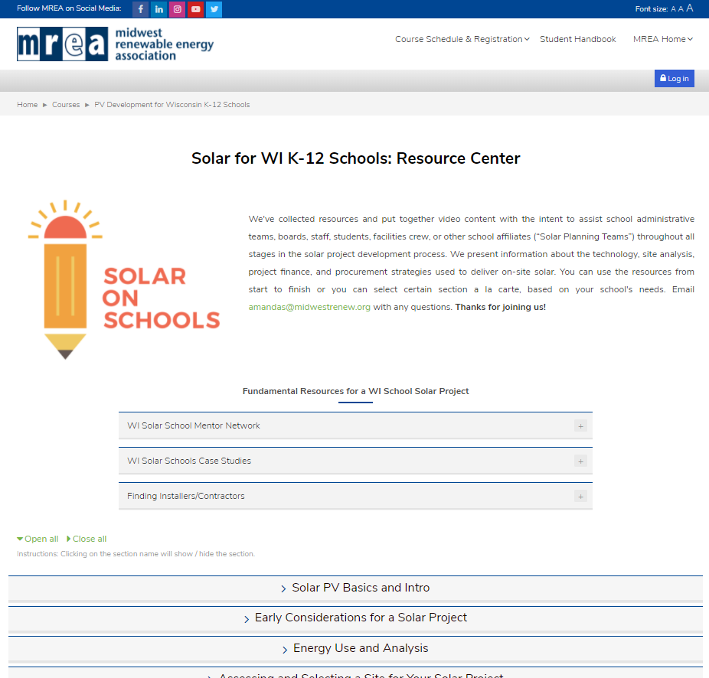
Next Steps:
Establish a School "Solar Planning Team" -- a group who will work together to build consensus and educate key stakeholders on the benefits and opportunities of going solar. This can be made up of a mix of:
School Board Members
Students
Teachers
Business Administrators
Facilities Staff
Community Members
Superintendent
And More

Slide 30
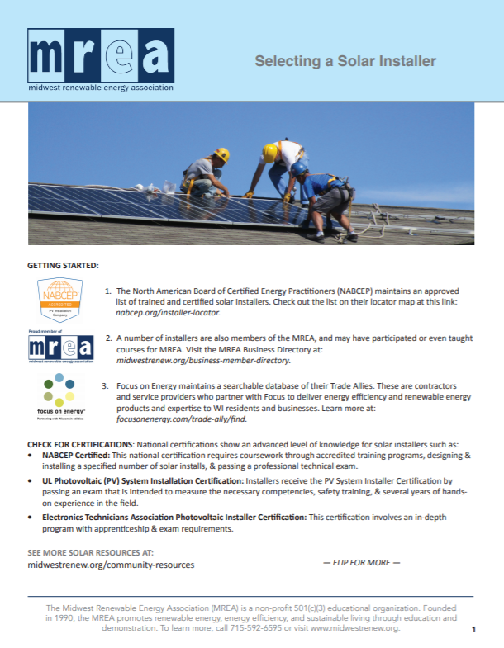
Next Steps:
Consult with a Contractor– may provide a site assessment and financial analysis at no cost – helping you decide if moving forward with a solar project is feasible. You can find contractors through these sites:
MREA Busines Member Directory
Focus on Energy Trade Allies
NABCEP
RENEW Wisconsin Business Members

Slide 31
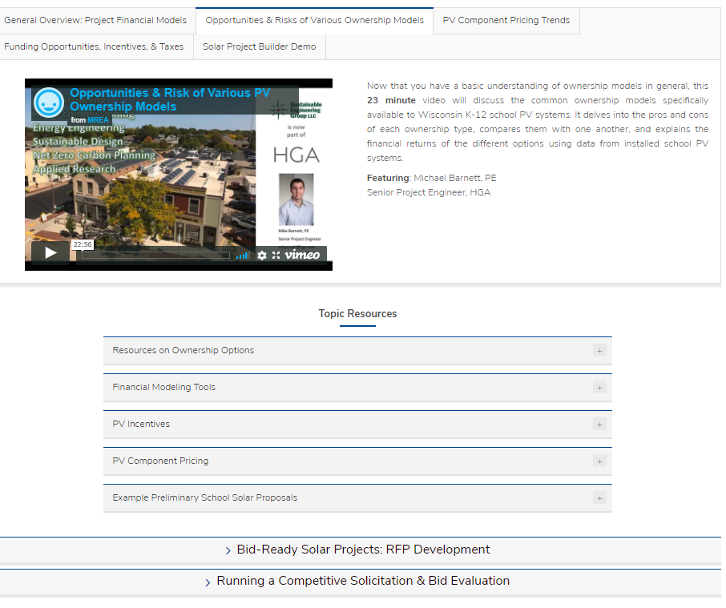
Next Steps:
Discuss and Determine Financing Options –
Total system cost
Operating budget availability
Go to referendum/tie solar into other facility upgrades
Availability/willingness to take out a loan
Fundraising opportunities
Grant availability
Required ROI to move forward
Ownership type – direct ownership, third party ownership, utility owned
Financial and PV Modeling Tools –
PVwatts.nrel.gov
SolarProjectBuilder.org
Notes:
These modelling tools can be used to help estimate system size, production, cost, and payback. We would like to know what you need to make a project move forward – do you need a certain amount fundraised, do you need a certain return on investment for the project, is the district willing/able to take out a low-interest loan? What can we do to help?

Slide 32
Next Steps:
Check out and learn from other schools' experiences by exploring the case studies on MREA's website
Contact other schools that have recently gone solar to learn from them
Notes:
Oregon School District – Forest Edge Elementary School. The first net zero energy school in Wisconsin. A 646 kW PV system with battery storage and geothermal heating. The school has NO natural gas connection.

